Slide 1


Evidence Based Dentistry
DEPH 312 Principles of Scientific Evidence
Talal Alshihayb ^{BDS, DScD}
Diplomate, American Board of Dental Public Health
Assistant Professor
Department of Preventive Dental Science, College of Dentistry, King Saud bin Abdulaziz University for Health Sciences
Department of Health Policy and Health Services Research, Henry M. Goldman School of Dental Medicine, Boston University
January 25, 2024
shihaybt@ksau-hs.edu.sa

Slide 2
Recap
Study tasks
Measures of disease occurrence
Measures of association
Study designs
Validity and precision
Random and systematic errors in research
Causality and causal effects
Variables and their description
Measures of central tendency and dispersion
Types of distributions and the theoretical distribution
Inferential statistics (p-values and confidence intervals)
Sampling
Evaluation of primary studies

Slide 3
The goal is to correctly estimate
For descriptive task
Measure of disease occurrence:
Prevalence
Incidence
For a predictive task
Mean squared error
Root mean squared error
Sensitivity
Specificity
Predictive value (positive or negative)
Area under the curve (ROC)
For a causal task
Measures of disease association:
Difference scale (risk difference, rate difference, time difference, etc.)
Ratio scale (risk ratio, rate ratio, odds ratio, time ratio, etc.)

Slide 4
Descriptive studies
Selection bias
Measurement bias
Misclassification bias (categorical)
Information bias
Hernán MA, Hsu J, Healy B. A second chance to get causal inference right: a classification of data science tasks. Chance. 2019 Jan 2;32(1):42-9.

Slide 5
Descriptive cross-sectional study
Was the sample taken randomly (selection bias)? How was it accounted for?
Was there non-response? How was it accounted for?
Were the outcome and/or covariates accurately measured (measurement bias)? How were they accounted for?
Was there sample size calculation? Was the sample size achieved?

Slide 6
Descriptive cohort study
Was the sample taken randomly (selection bias)? How was it accounted for?
Was there non-response at or after baseline? How was it accounted for?
Were the outcome and/or covariates accurately measured (measurement bias)? How were they accounted for?
Was there sample size calculation? Was the sample size achieved?

Slide 7









Potential explanations of an association in Causal studies
Systematic errors
1
2
3
4
5
6
Random error
Sharing a common cause
(confounding bias)
Conditioning on a common effect
(selection bias)
Measurement error
(measurement bias)
Reverse causation
Causal

Slide 8
Randomized clinical trials (RCTs)
RoB 2 (Risk of Bias 2): https://www.riskofbias.info/welcome/rob-2-0-tool/current-version-of-rob-2
RoB 2 for cluster-randomized trials: https://www.riskofbias.info/welcome/rob-2-0-tool/rob-2-for-cluster-randomized-trials
Rob 2 for crossover trials: https://www.riskofbias.info/welcome/rob-2-0-tool/rob-2-for-crossover-trials
CASP (Critical Appraisal Skills Programme) for Randomised Controlled Trial Checklist: https://casp-uk.net/images/checklist/documents/CASP-Randomised-Controlled-Trial-Checklist/CASP-RCT-Checklist-PDF-Fillable-Form.pdf

Slide 9
Causal cohort study
ROBINS-E (Risk Of Bias in Non-randomized Studies of Exposures): https://www.riskofbias.info/welcome/robins-e-tool
ROBINS-I (Risk Of Bias in Non-randomized Studies of Interventions): https://www.riskofbias.info/welcome/home
STROBE (STrengthening the Reporting of OBservational studies in Epidemiology): https://www.strobe-statement.org/checklists/
CASP: https://casp-uk.net/images/checklist/documents/CASP-Cohort-Study-Checklist/CASP-Cohort-Study-Checklist-2018_fillable_form.pdf

Slide 10
Case-control
ROBINS-E (Risk Of Bias in Non-randomized Studies of Exposures): https://www.riskofbias.info/welcome/robins-e-tool
ROBINS-I (Risk Of Bias in Non-randomized Studies of Interventions): https://www.riskofbias.info/welcome/home
STROBE (STrengthening the Reporting of OBservational studies in Epidemiology): https://www.strobe-statement.org/checklists/
CASP: https://casp-uk.net/images/checklist/documents/CASP-Case-Control-Study-Checklist/CASP-Case-Control-Study-Checklist-2018-fillable-form.pdf

Slide 11
Causal cross-sectional study
ROBINS-E (Risk Of Bias in Non-randomized Studies of Exposures): https://www.riskofbias.info/welcome/robins-e-tool
ROBINS-I (Risk Of Bias in Non-randomized Studies of Interventions): https://www.riskofbias.info/welcome/home
STROBE (STrengthening the Reporting of OBservational studies in Epidemiology): https://www.strobe-statement.org/checklists/

Slide 12

LECTURE LEARNING OUTCOMES OF EACH OF THE DIDACTIC SESSIONS
REFERENCE:
Chapter 11 in Dentistry, Dental Practice, and the Community 7th edition
P. 190-191 in Epidemiology by Design
Chapter 34 in Oral Epidemiology A Textbook on Oral Health Conditions, Research Topics and Methods
LECTURE LEARNING OUTCOMES:
Define evidence-based dentistry.
Define systematic review.
Recognize how to conduct a systematic review.

Slide 13

What is evidence based dentistry?
“Doing the right thing, for the right patient, at the right time”
“The conscientious, explicit, and judicious use of current best evidence in making decisions about the care of individual patients. The practice of evidence-based medicine means integrating individual clinical expertise with the best available external clinical evidence from systematic research”
Sackett D.L.S.S., Richardson W.S., Rosenberg W., Haynes R.B. Evidence-Based Medicine: How to Practice and Teach EBM. 2nd ed. Edinburgh: Churchill Livingstone; 2000.

Slide 14
Components of Evidence based dentistry
Scientific basis (research)
Clinical expertise (clinician)
Patient’s value (patient)

Slide 15
Evidence based dentistry
Assemble evidence
Evaluate evidence
Summarize evidence

Slide 16
Why evidence synthesis or summary?

Slide 17
Evidence based dentistry
Narrative
Unstructured search of the literature
Informal
Subjective evaluation
Often based on the opinion of the author/s of the review
Systematic
Structured search of the literature
Formal
Objective evaluation (however this is often violated)
May include quantitative analysis (summary)

Slide 18
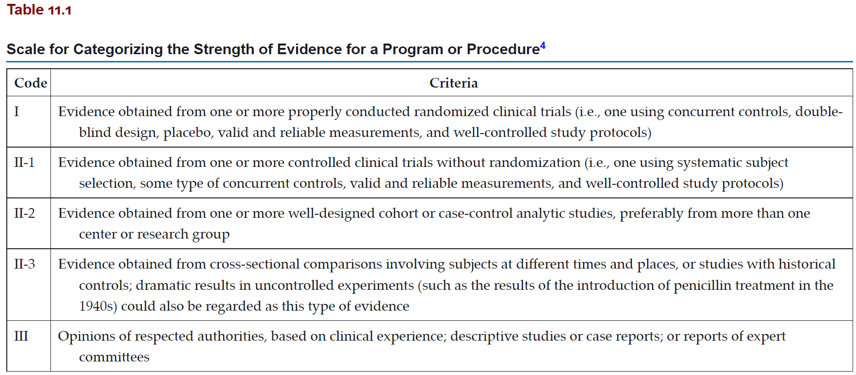
Strength of evidence

Slide 19

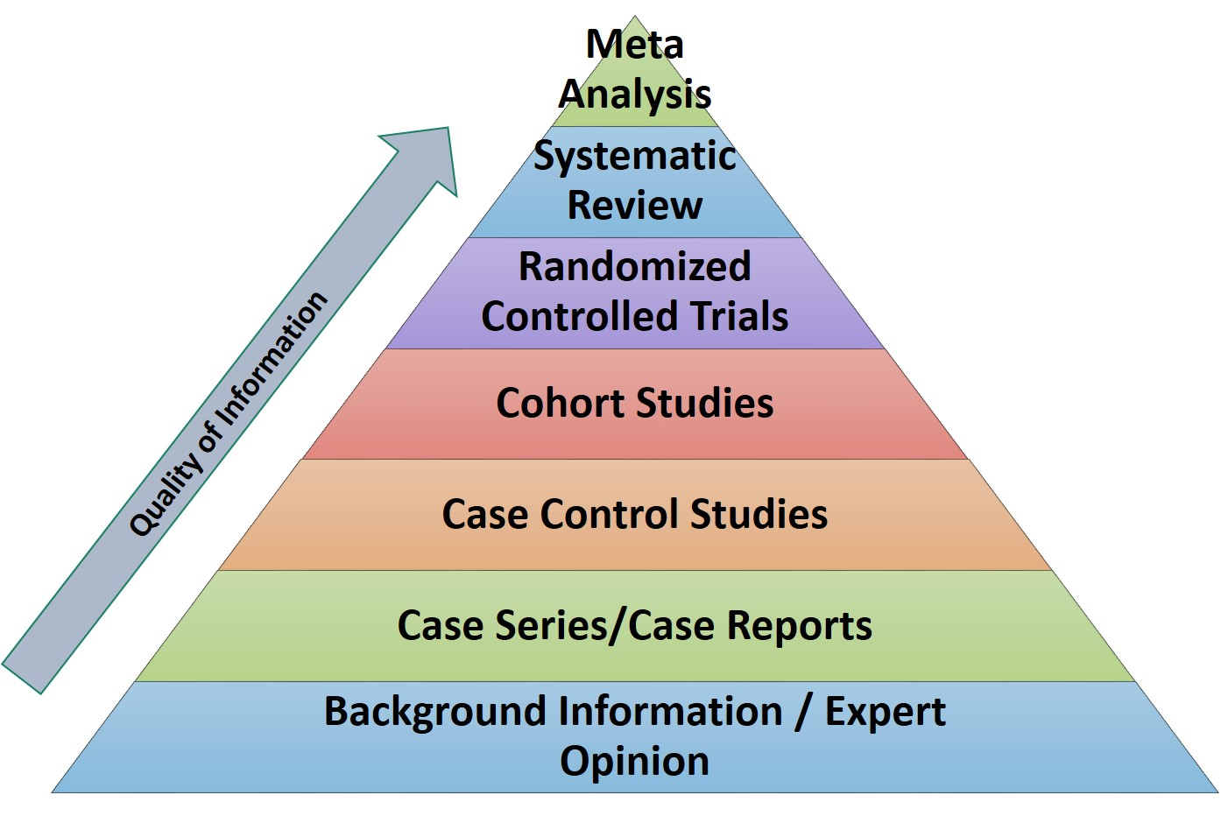
https://www.google.com/url?sa=i&url=https%3A%2F%2Flibrary.triton.edu%2Fc.php%3Fg%3D433673%26p%3D3720267&psig=AOvVaw2Gn9hmhr8Okj3uU0tuJti3&ust=1632053370437000&source=images&cd=vfe&ved=0CAsQjRxqFwoTCKD1luG-iPMCFQAAAAAdAAAAABAJ

Slide 20


Slide 21
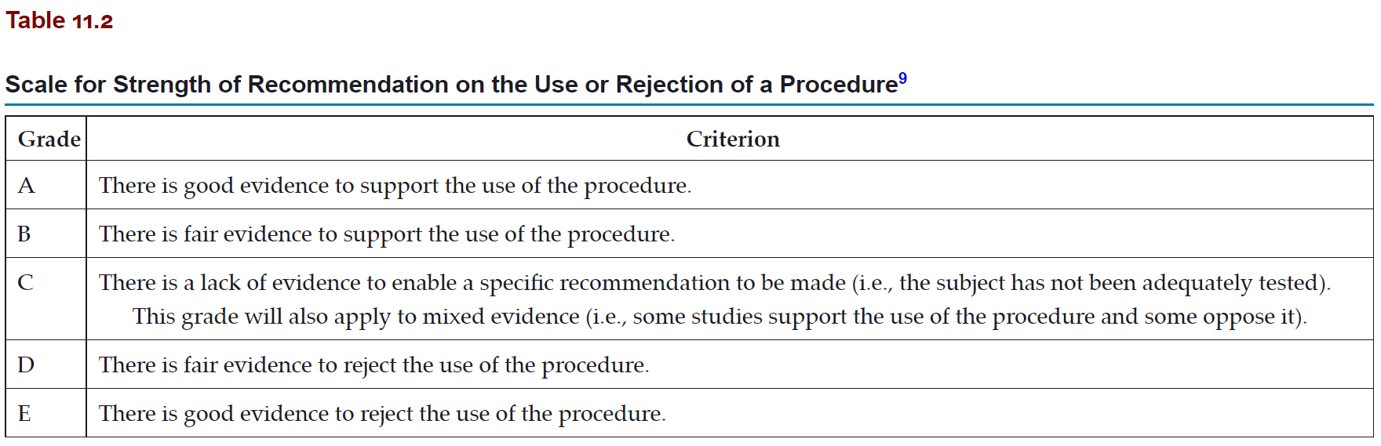
Strength of recommendation

Slide 22
Primary vs. secondary studies
Primary studies
We collect data or use data by other to conduct an analysis
Include: RCT, cohort, case-control, cross-sectional, and ecological
Secondary studies
Studies of studies
Narrative reviews
Systematic reviews and meta-analysis

Slide 23
Why the need for systematic reviews?
Summarize the literature on a certain topic
Understand where the science currently is in a certain topic

Slide 24
What is a systematic review?
“A review of a clearly formulated question that uses systematic and explicit methods to identify, select, and critically appraise relevant research, and to collect and analyze data from the studies that are included in the review”
Higgins JaG S. Cochrane Handbook for Systematic Reviews of Interventions. In: Library T.C., ed. Chichester. UK: John Wiley & Sons, Ltd.; 2006.

Slide 25
Systematic reviews
Start with a research question (PICOT)
The research questions guides the search strategy
Screen the papers and apply inclusion/exclusion criteria
Appraise the included papers based on tools (e.g., ROB 2, ROBIN-E, ROBIN-I, STROBE, CASP, etc.)
Report based on (PRISMA: Preferred Reporting Items for Systematic reviews and Meta-analysis)

Slide 26
Systematic vs. narrative reviews
Systematic reviews is transparent about:
Research question
Literature search strategy
Inclusion and exclusion criteria of studies
What is extracted from studies
How studies are appraised
How authors of systematic review reached a conclusion

Slide 27
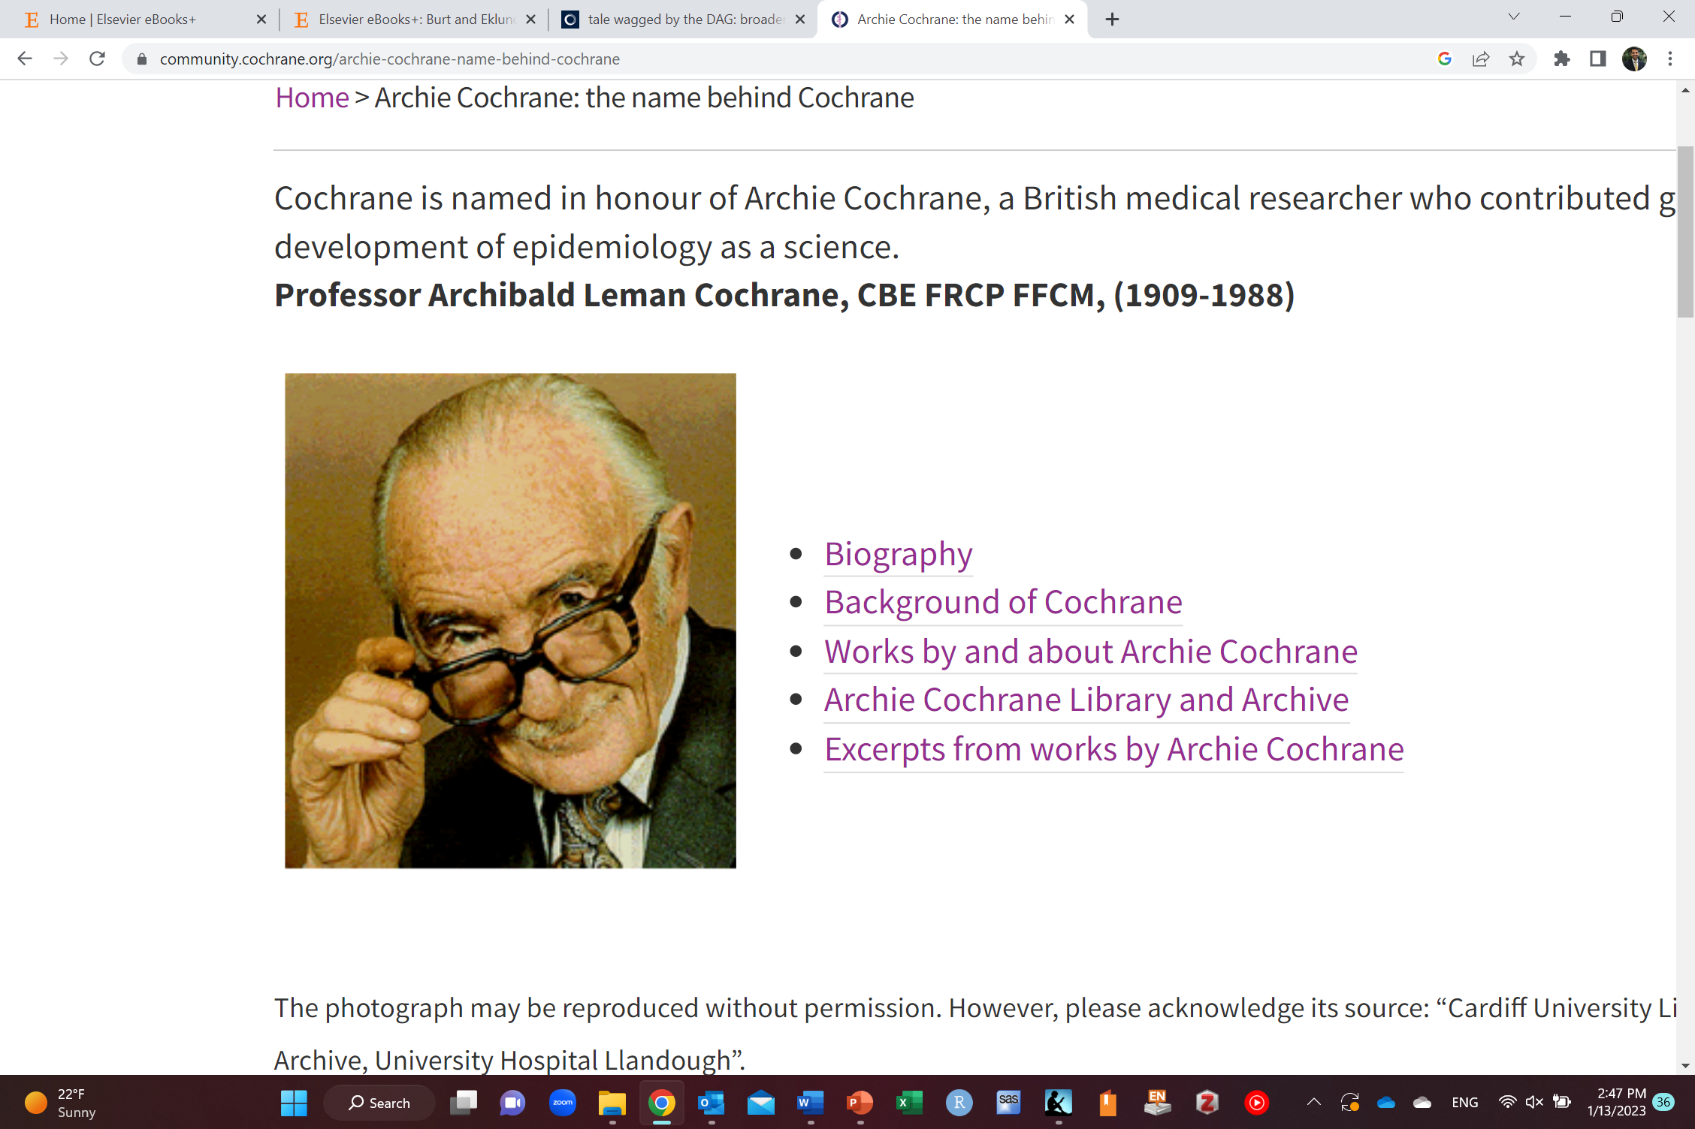
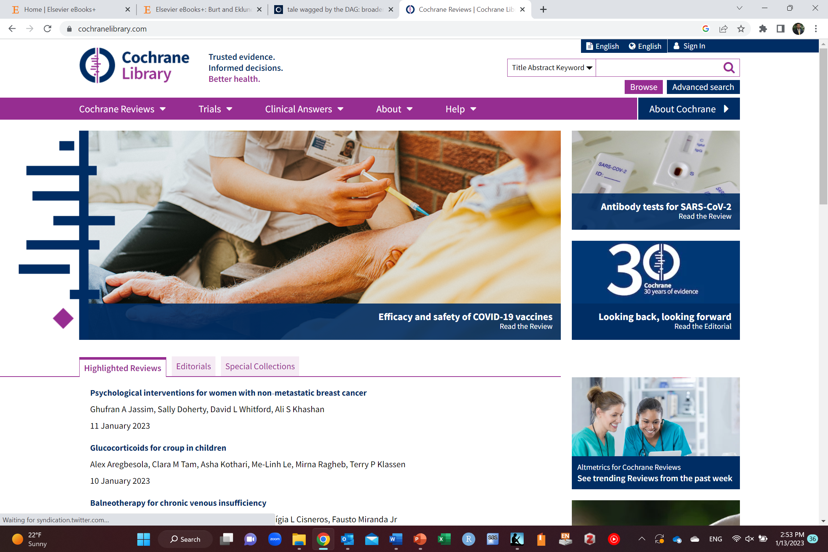
Cochrane collaboration
After British epidemiologist: Archie Cochrane
Non-profit organization
Up-to-date health information
Cochrane database of systematic reviews (part of
Cochrane Library)
Cardiff University Library, Cochrane Archive, University Hospital Llandough

Slide 28

Cochrane Oral Health Group

Slide 29
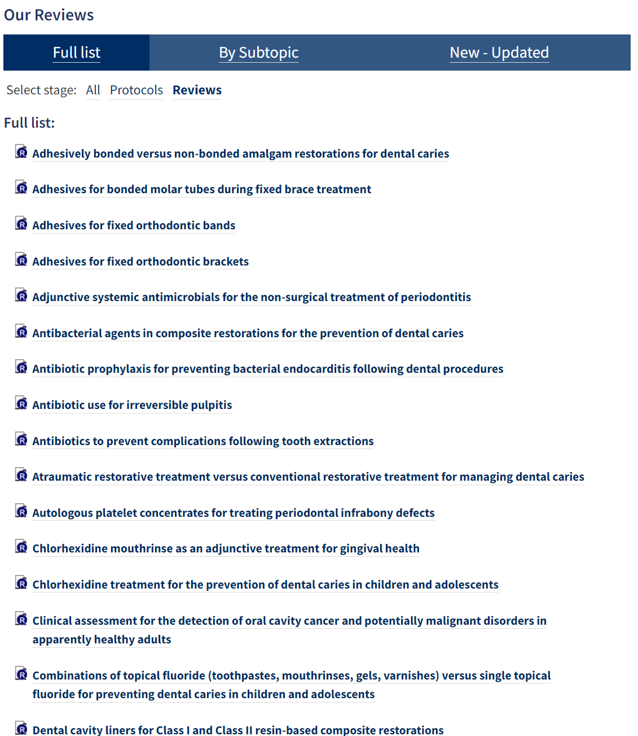
https://oralhealth.cochrane.org/oral-health-evidence

Slide 30
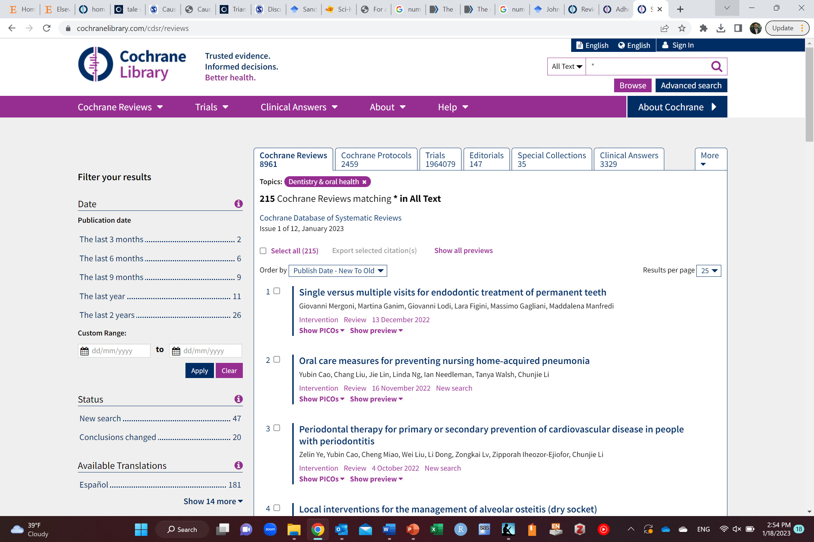

Slide 31
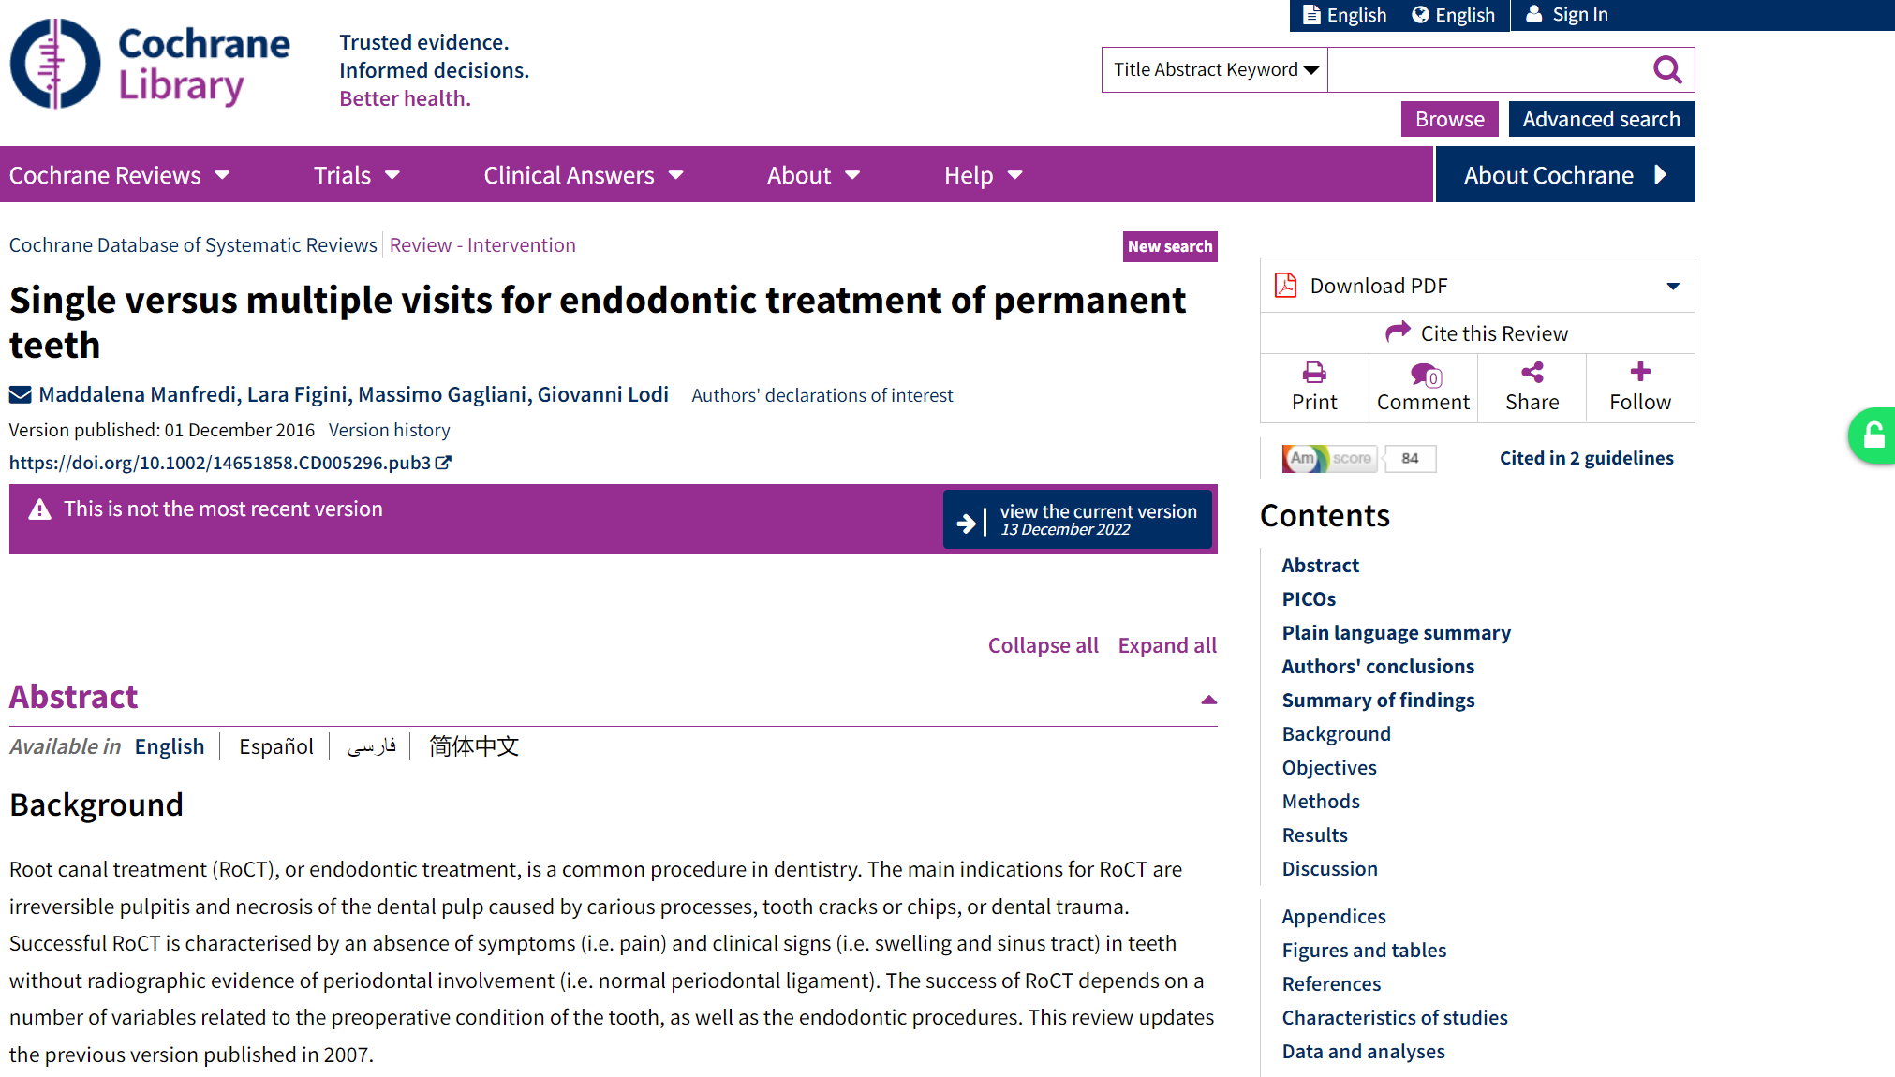

Slide 32
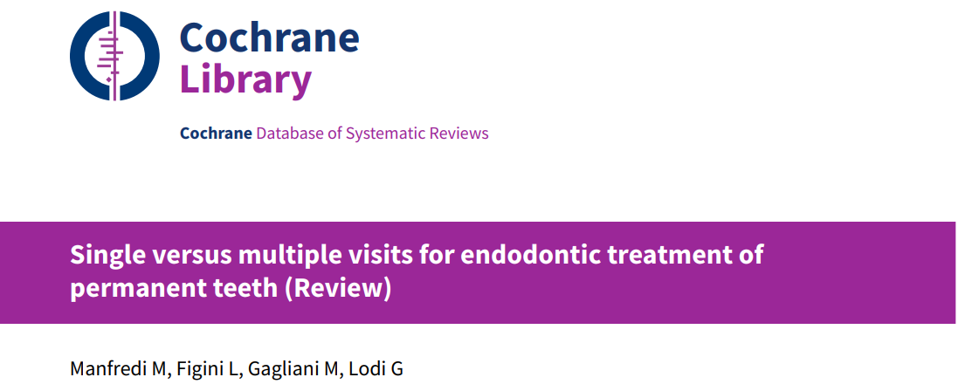

Slide 33
Conducting a systematic review
Formulate a research question using PICOT
Decide on inclusion and exclusion criteria of studies
Build a search strategy using PICOT
Data collection/extraction
Assess the included studies based on objective criteria
Conclude

Slide 34
Research question
P: population
I: intervention or E: exposure
C: comparison
O: outcome
T: time frame

Slide 35
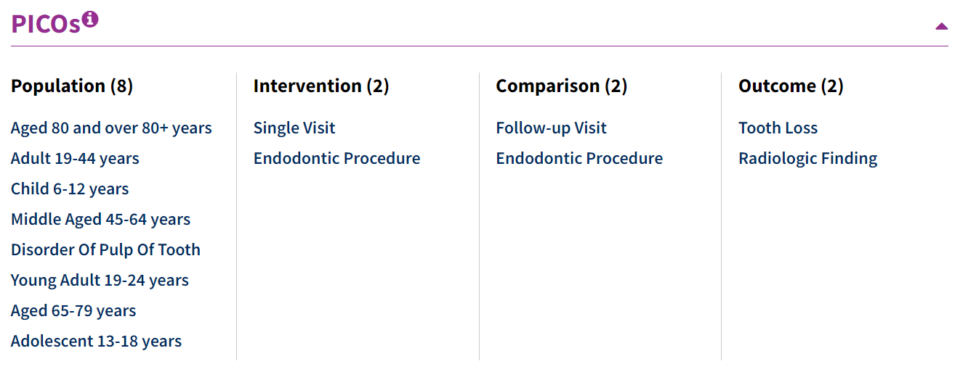

Slide 36
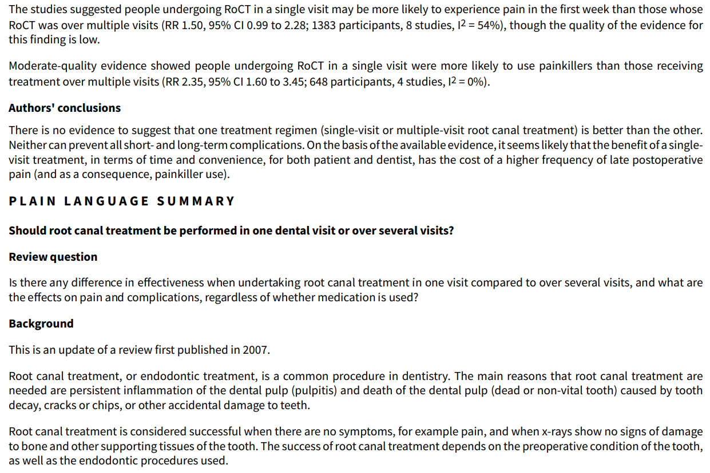

Slide 37
Inclusion and exclusion criteria
For example:
Age: adults or children or elderly
Language of studies: English
Study design
Certain years
Etc.

Slide 38
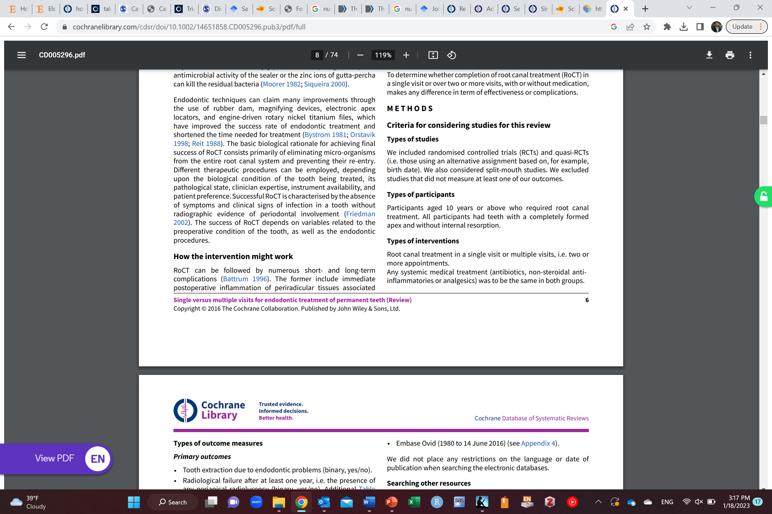
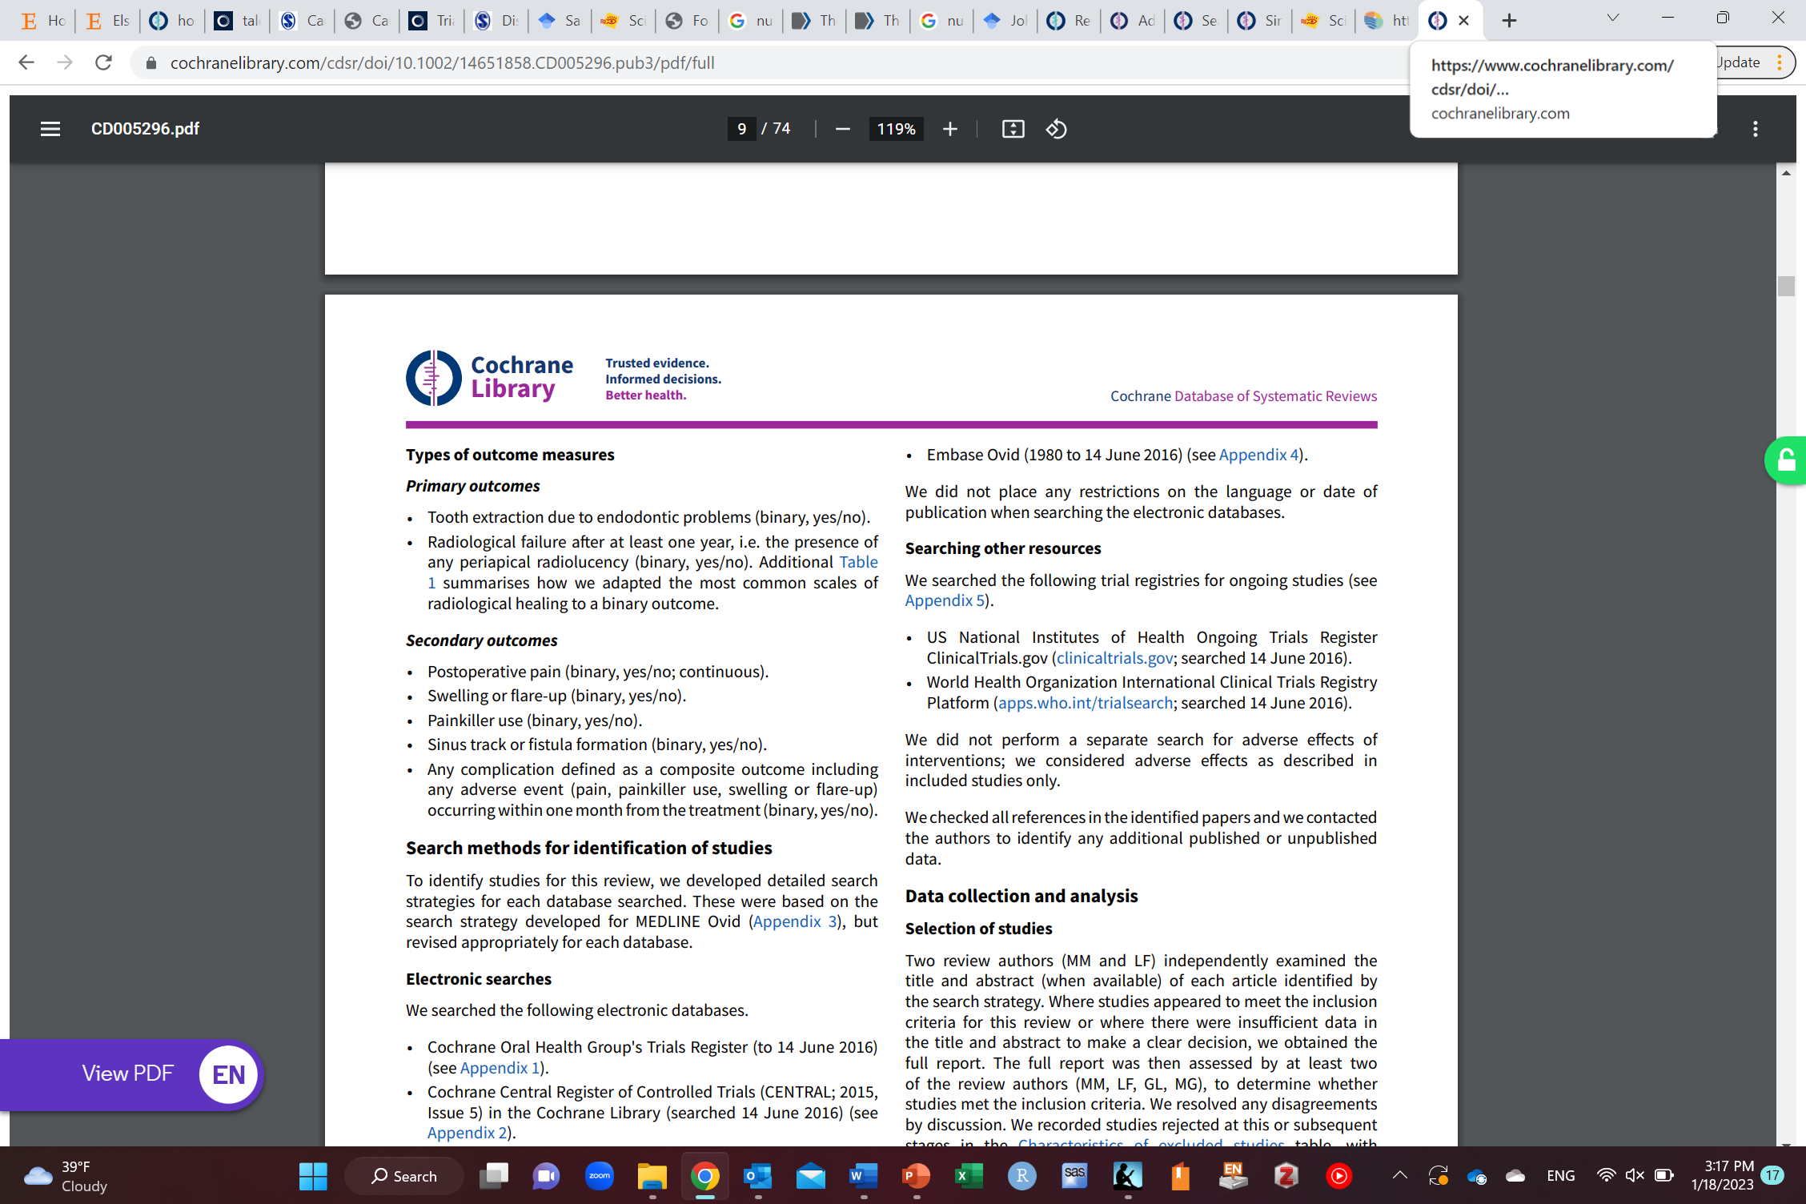

Slide 39
Search Strategy
Comprehensive search
Using PICOT
Identify keywords from the PICT
Search electronic databases using keywords with (and, or, not)
MEDLINE (Medical Literature Analysis and Retrieval System)
PUBMED
EMBASE
CINHAL
Cochrane library
Scopus
Trial registries
Etc.
Manual search using references of studies (cross-referencing)
Screen papers

Slide 40
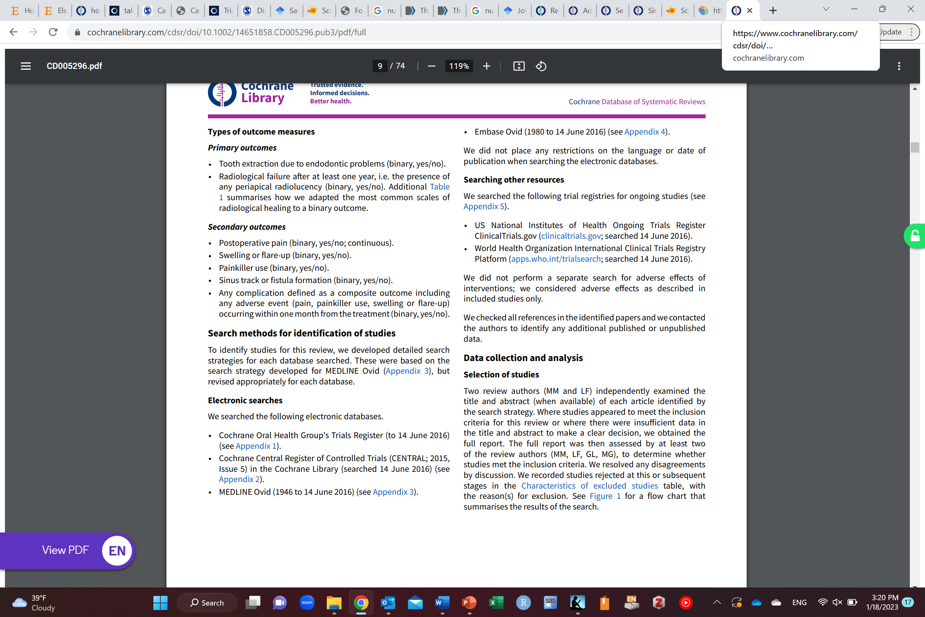

Slide 41
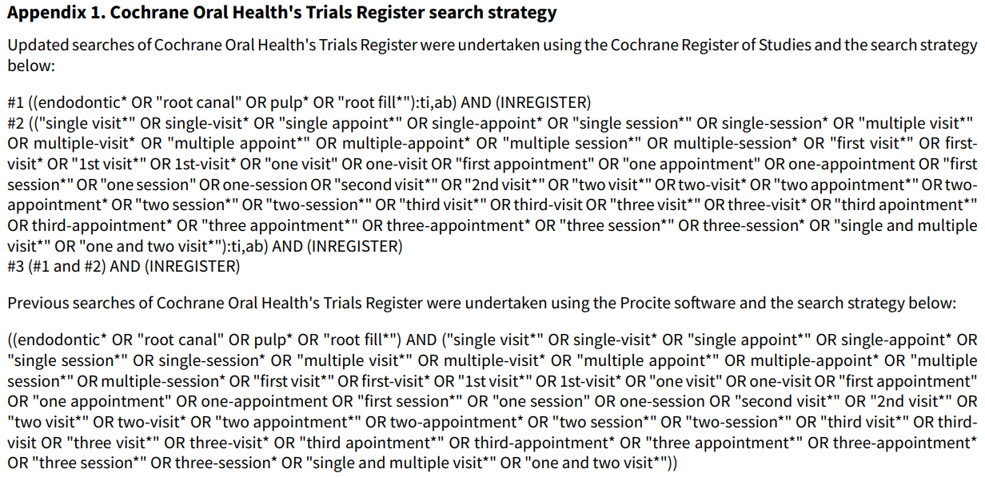

Slide 42
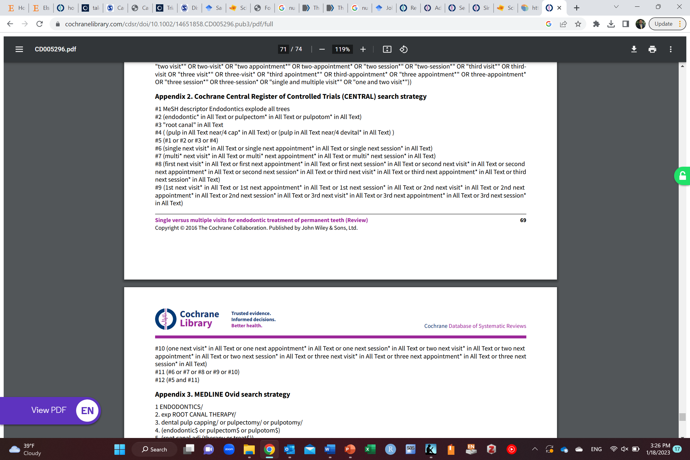

Slide 43
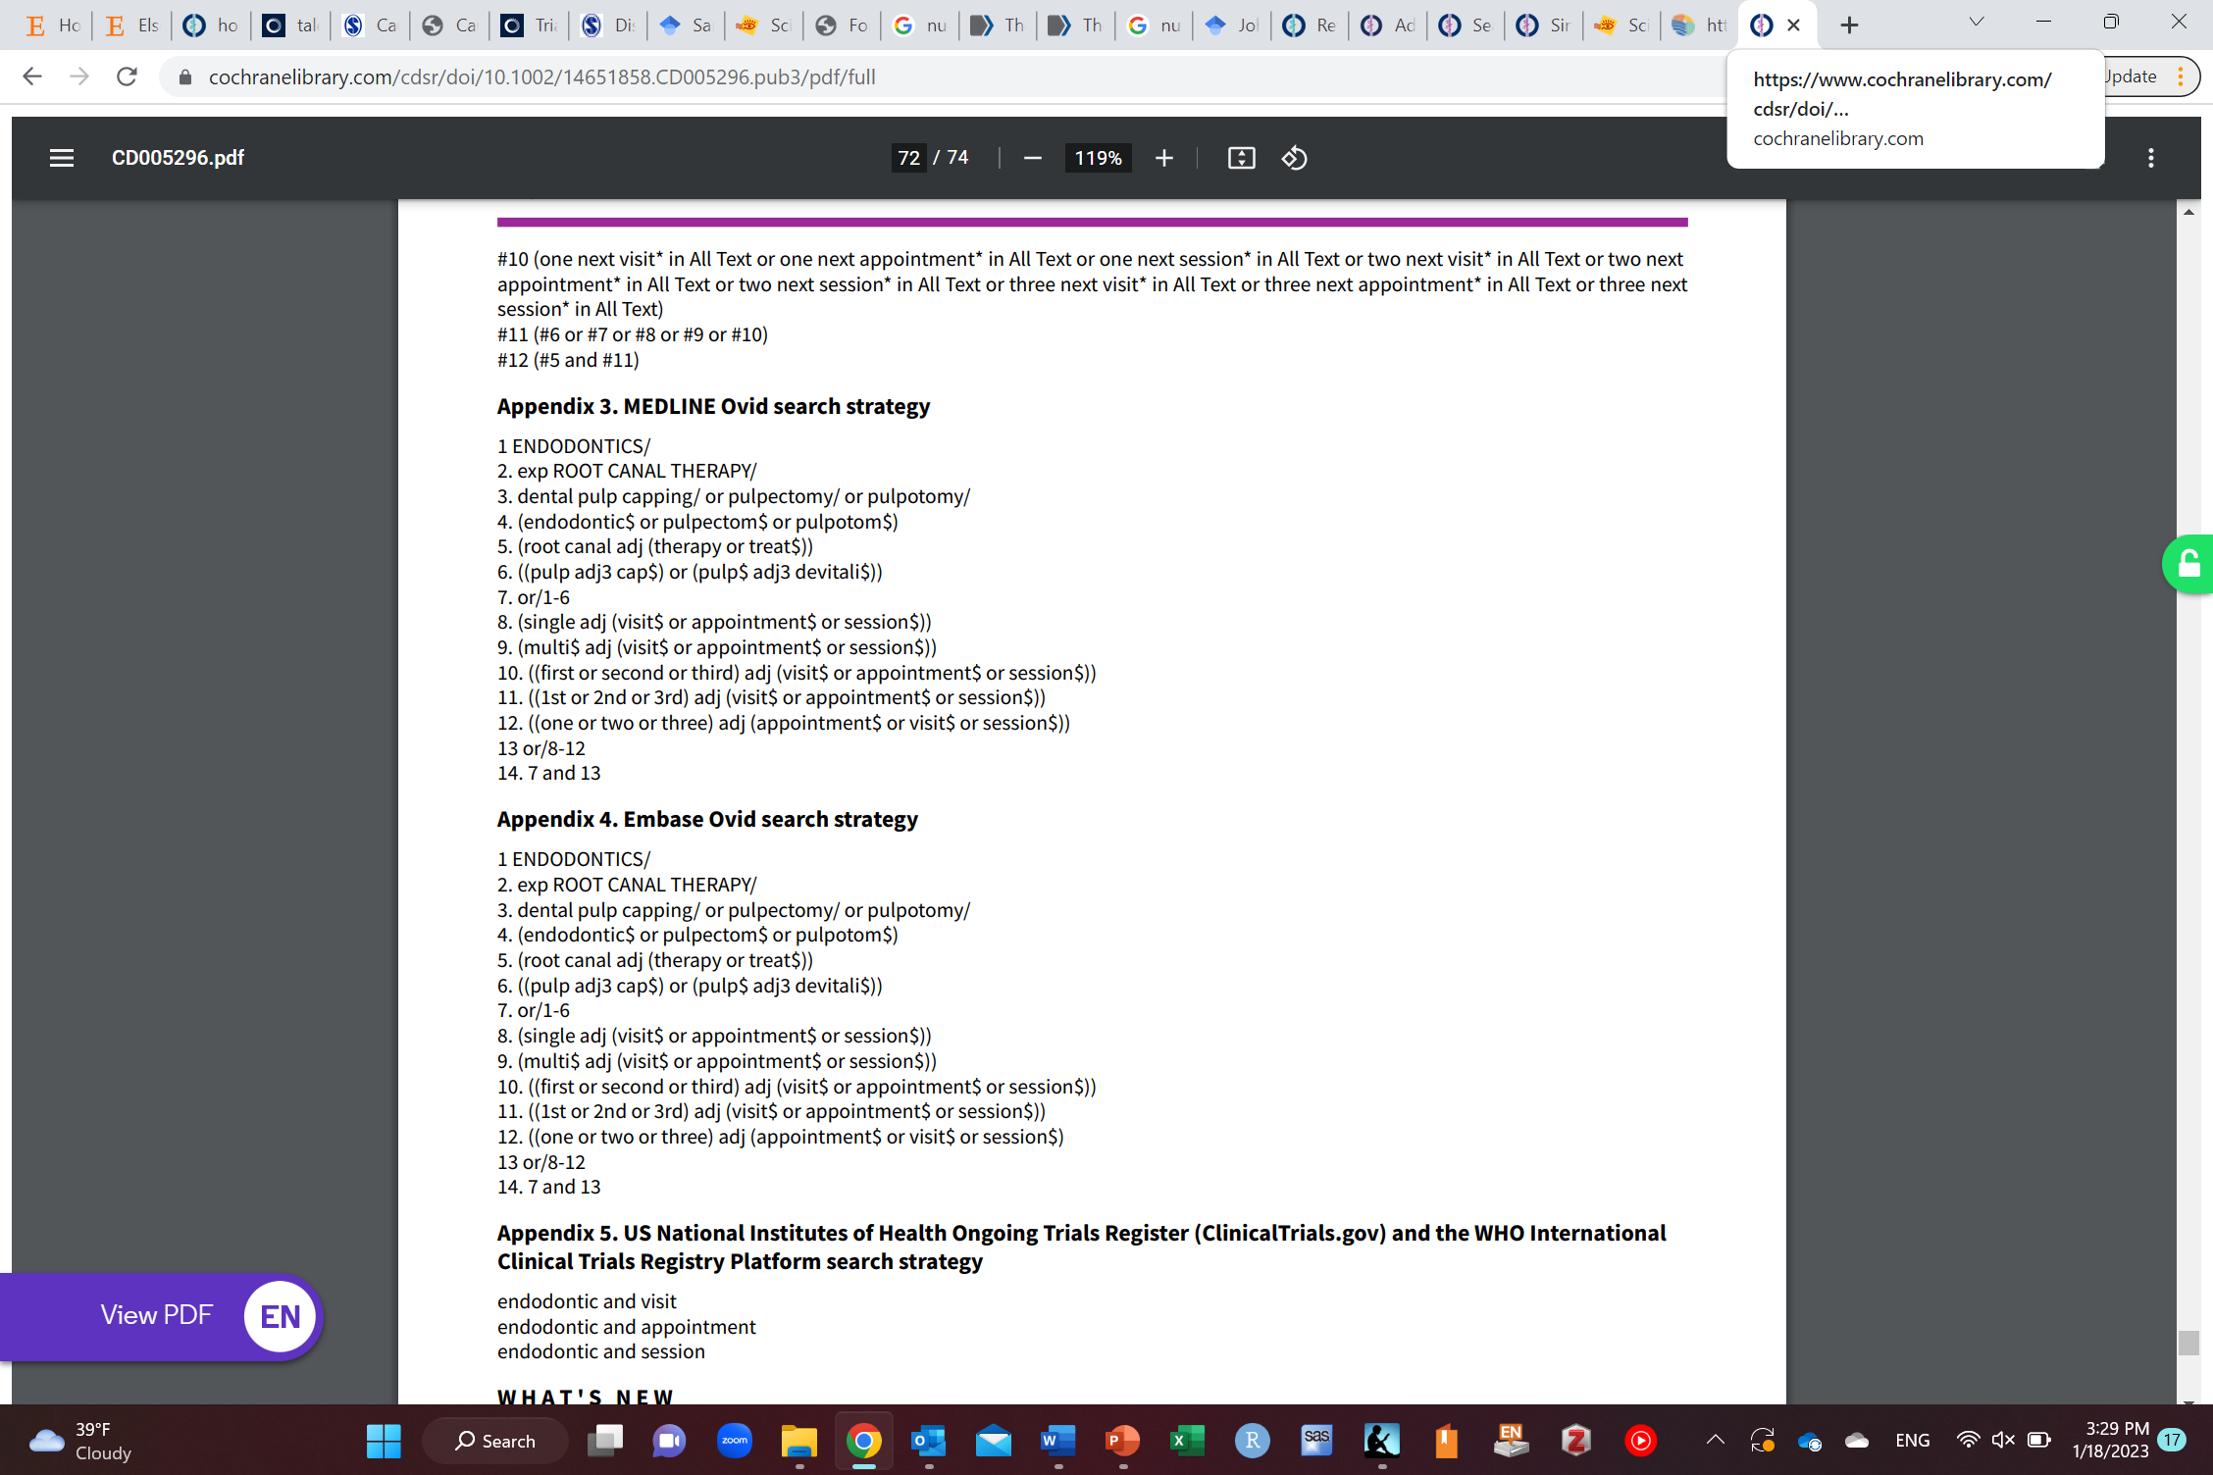
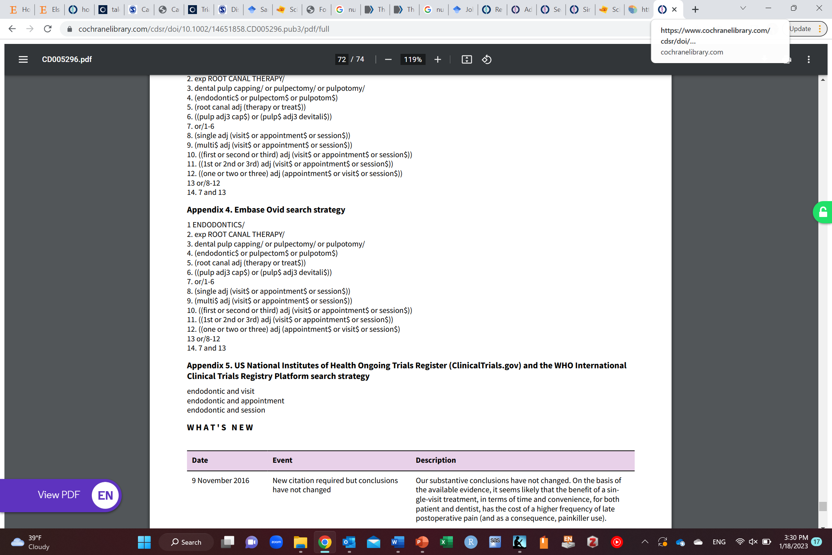

Slide 44
Data collection/extraction
What data you will extract from studies?
Who will extract them?
How?

Slide 45
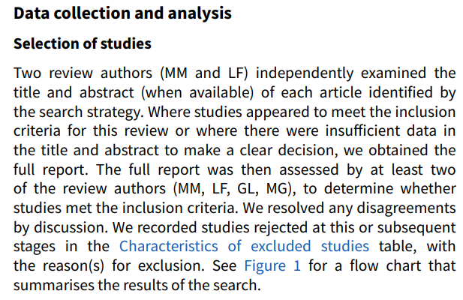

Slide 46
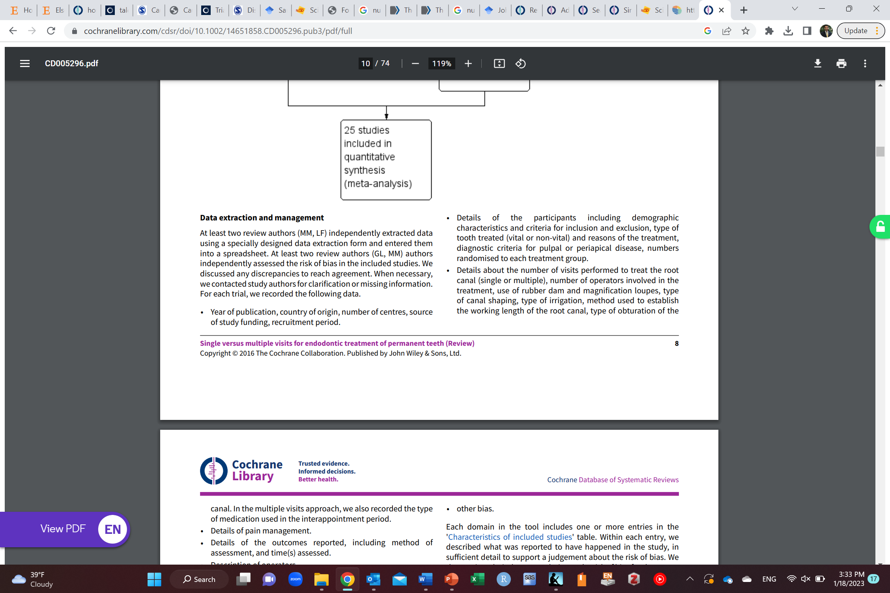
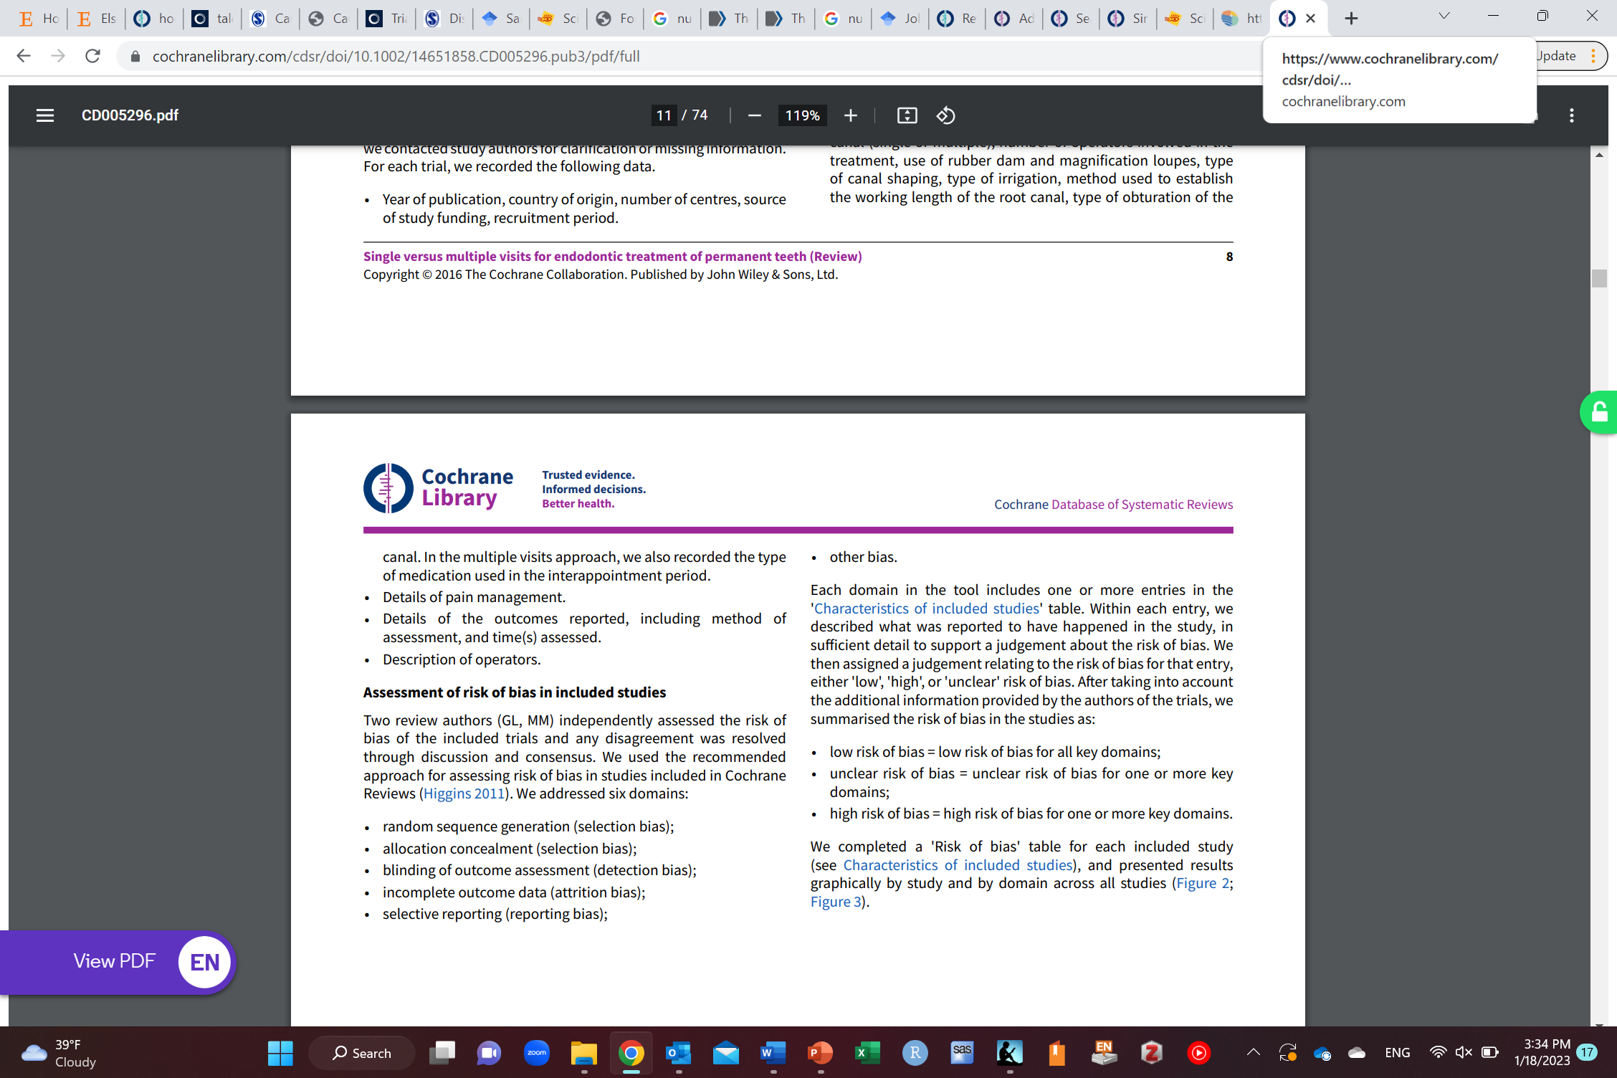

Slide 47
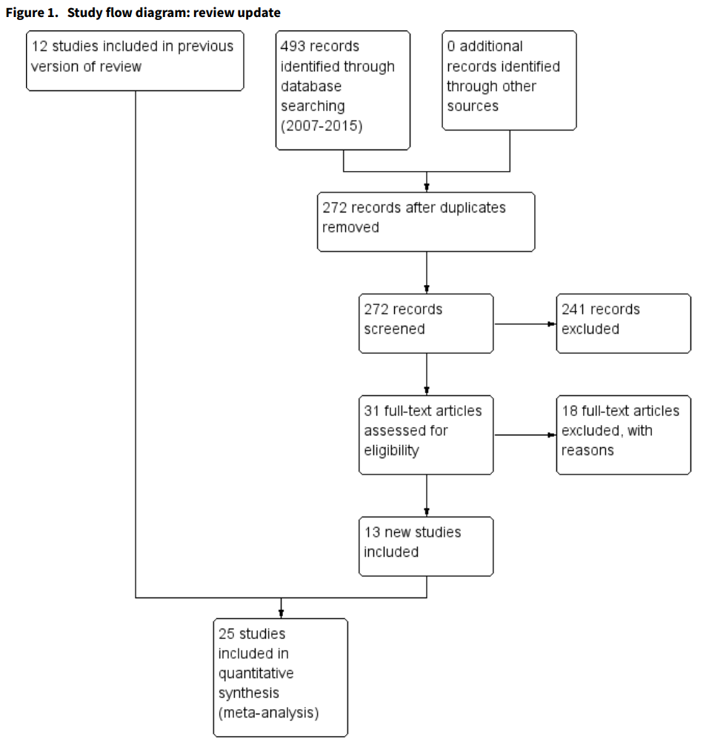

Slide 48
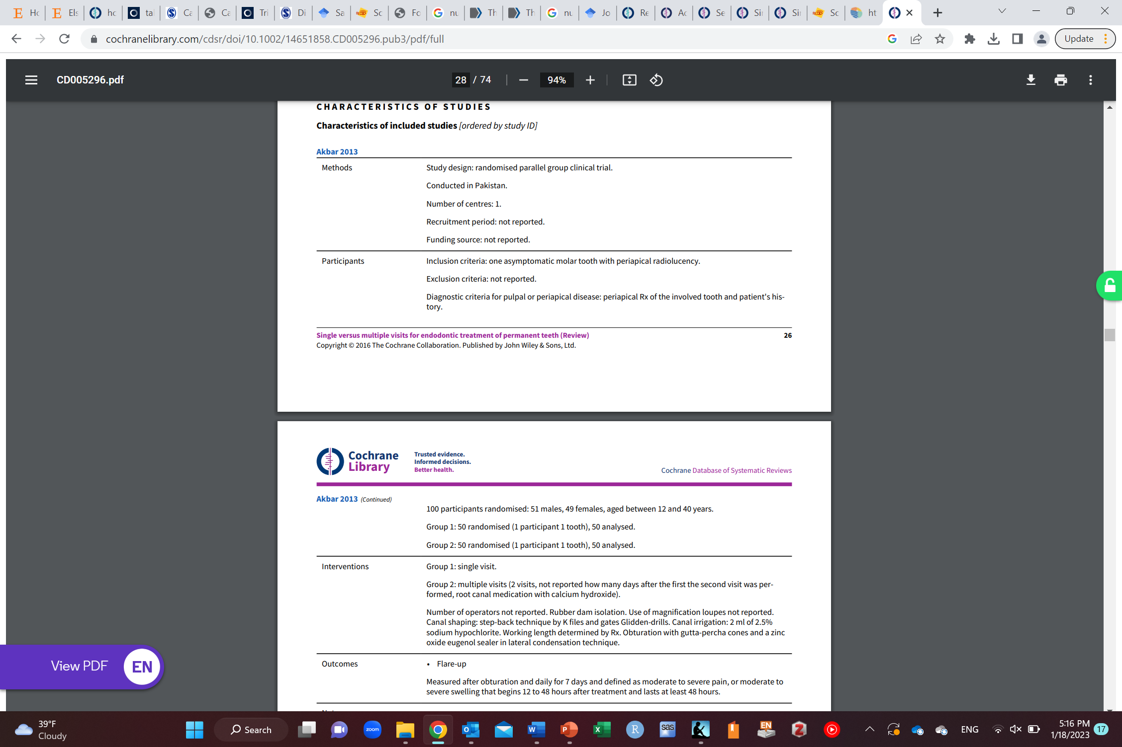
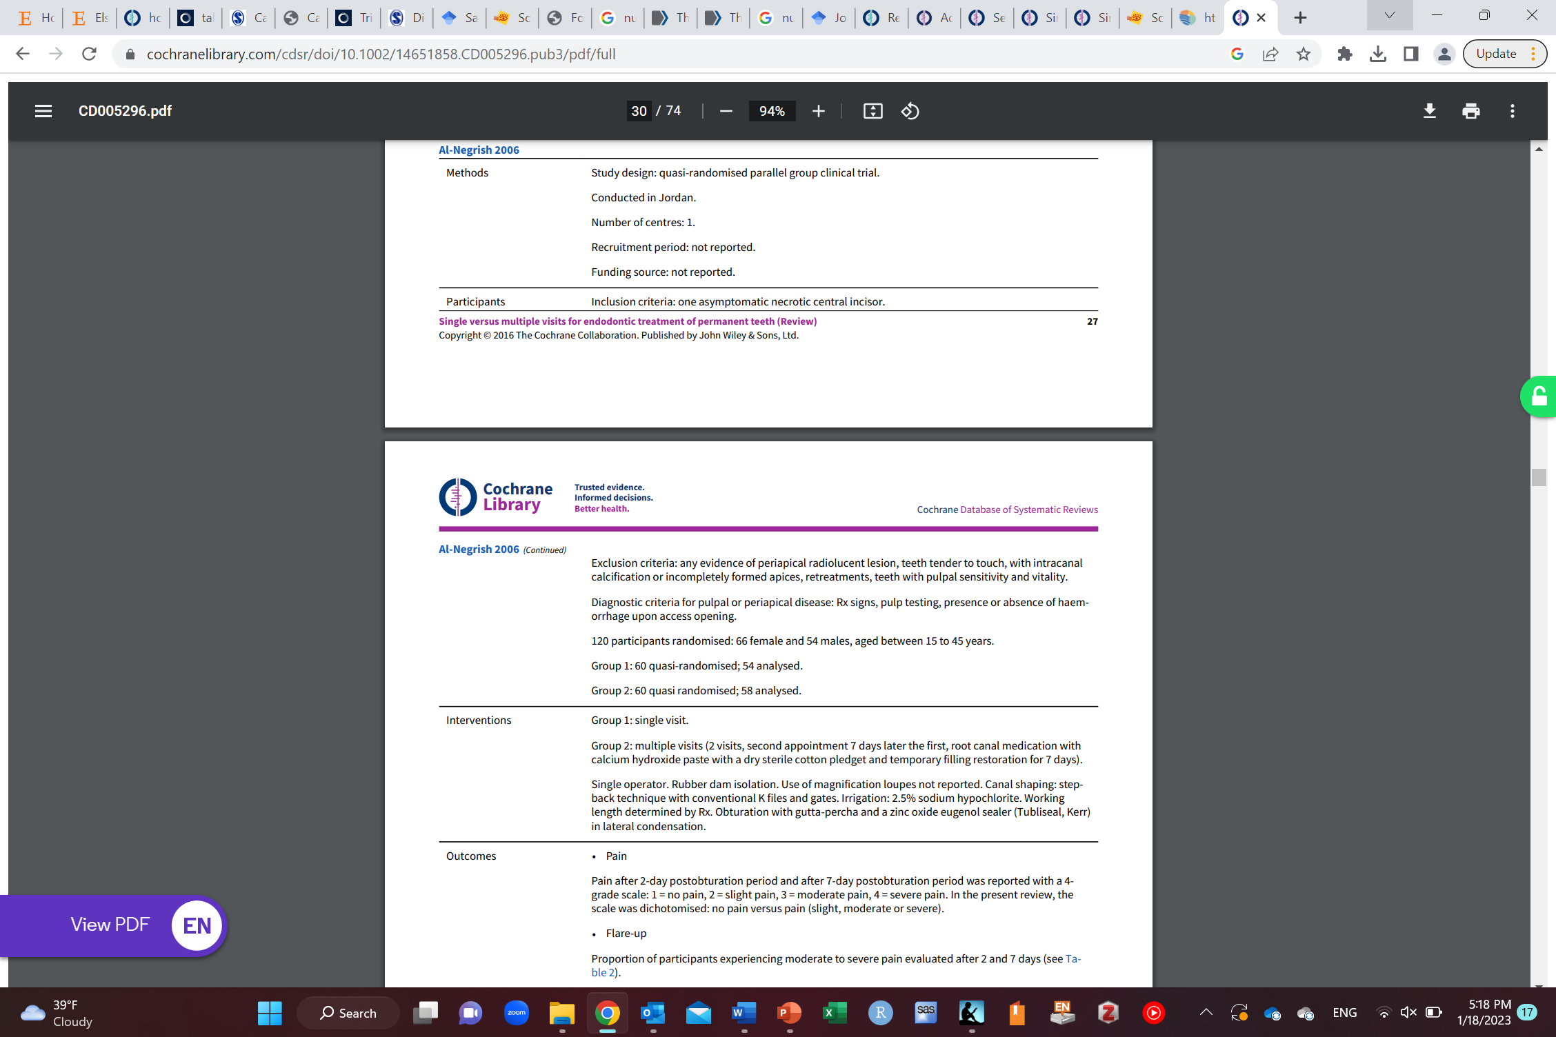
These two are examples of studies included, but you need to do this for all included studies

Slide 49
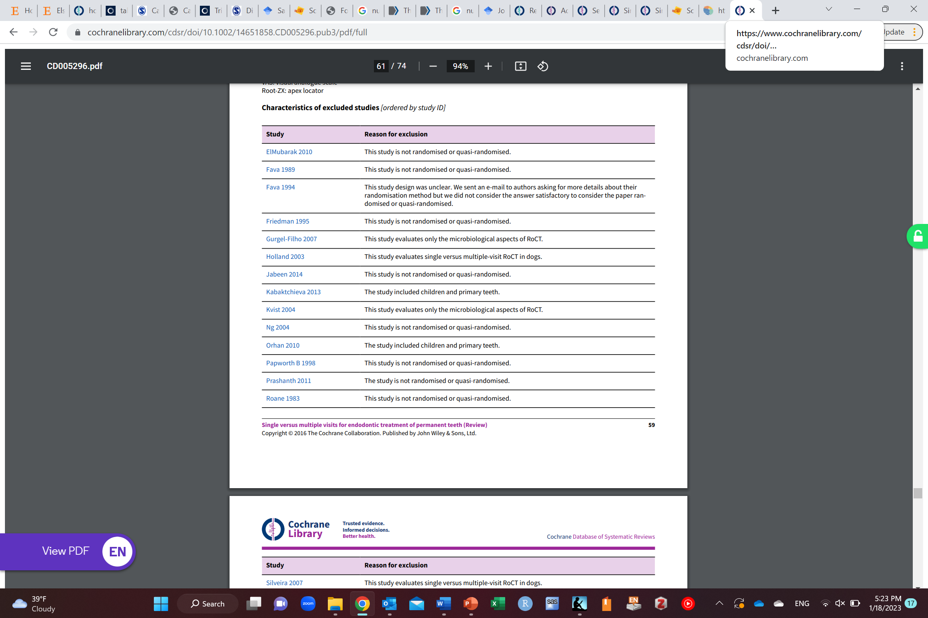
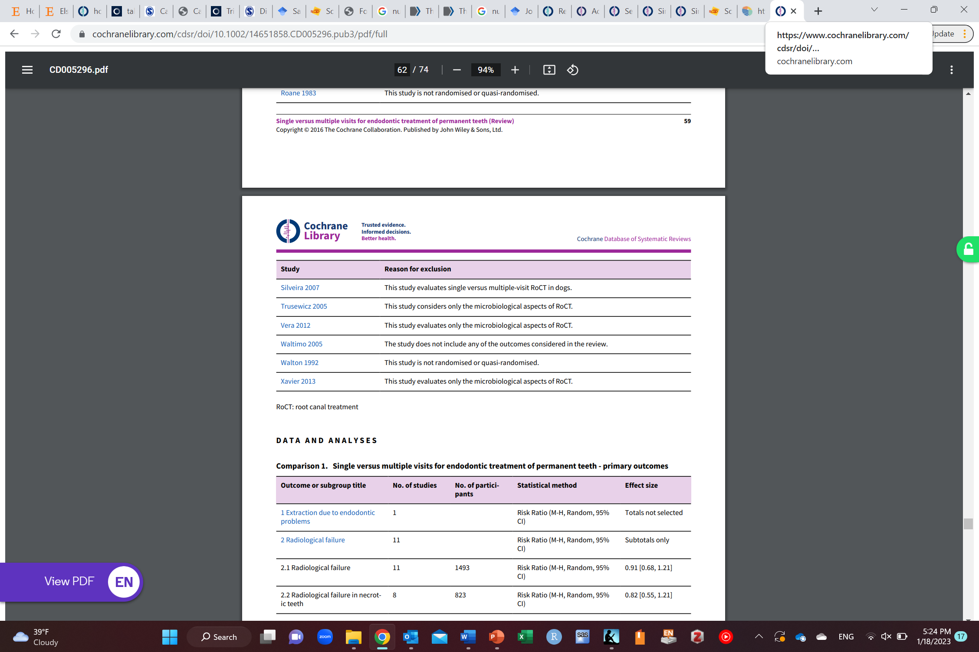

Slide 50
Assess included studies
Should be objective assessment of studies
Study design
Selection bias
Measurement bias
Confounding bias
Random error
Other assumptions
Etc.
Using risk assessment tools (ROB2, ROBINS-I/E, STROBE, Etc.)

Slide 51
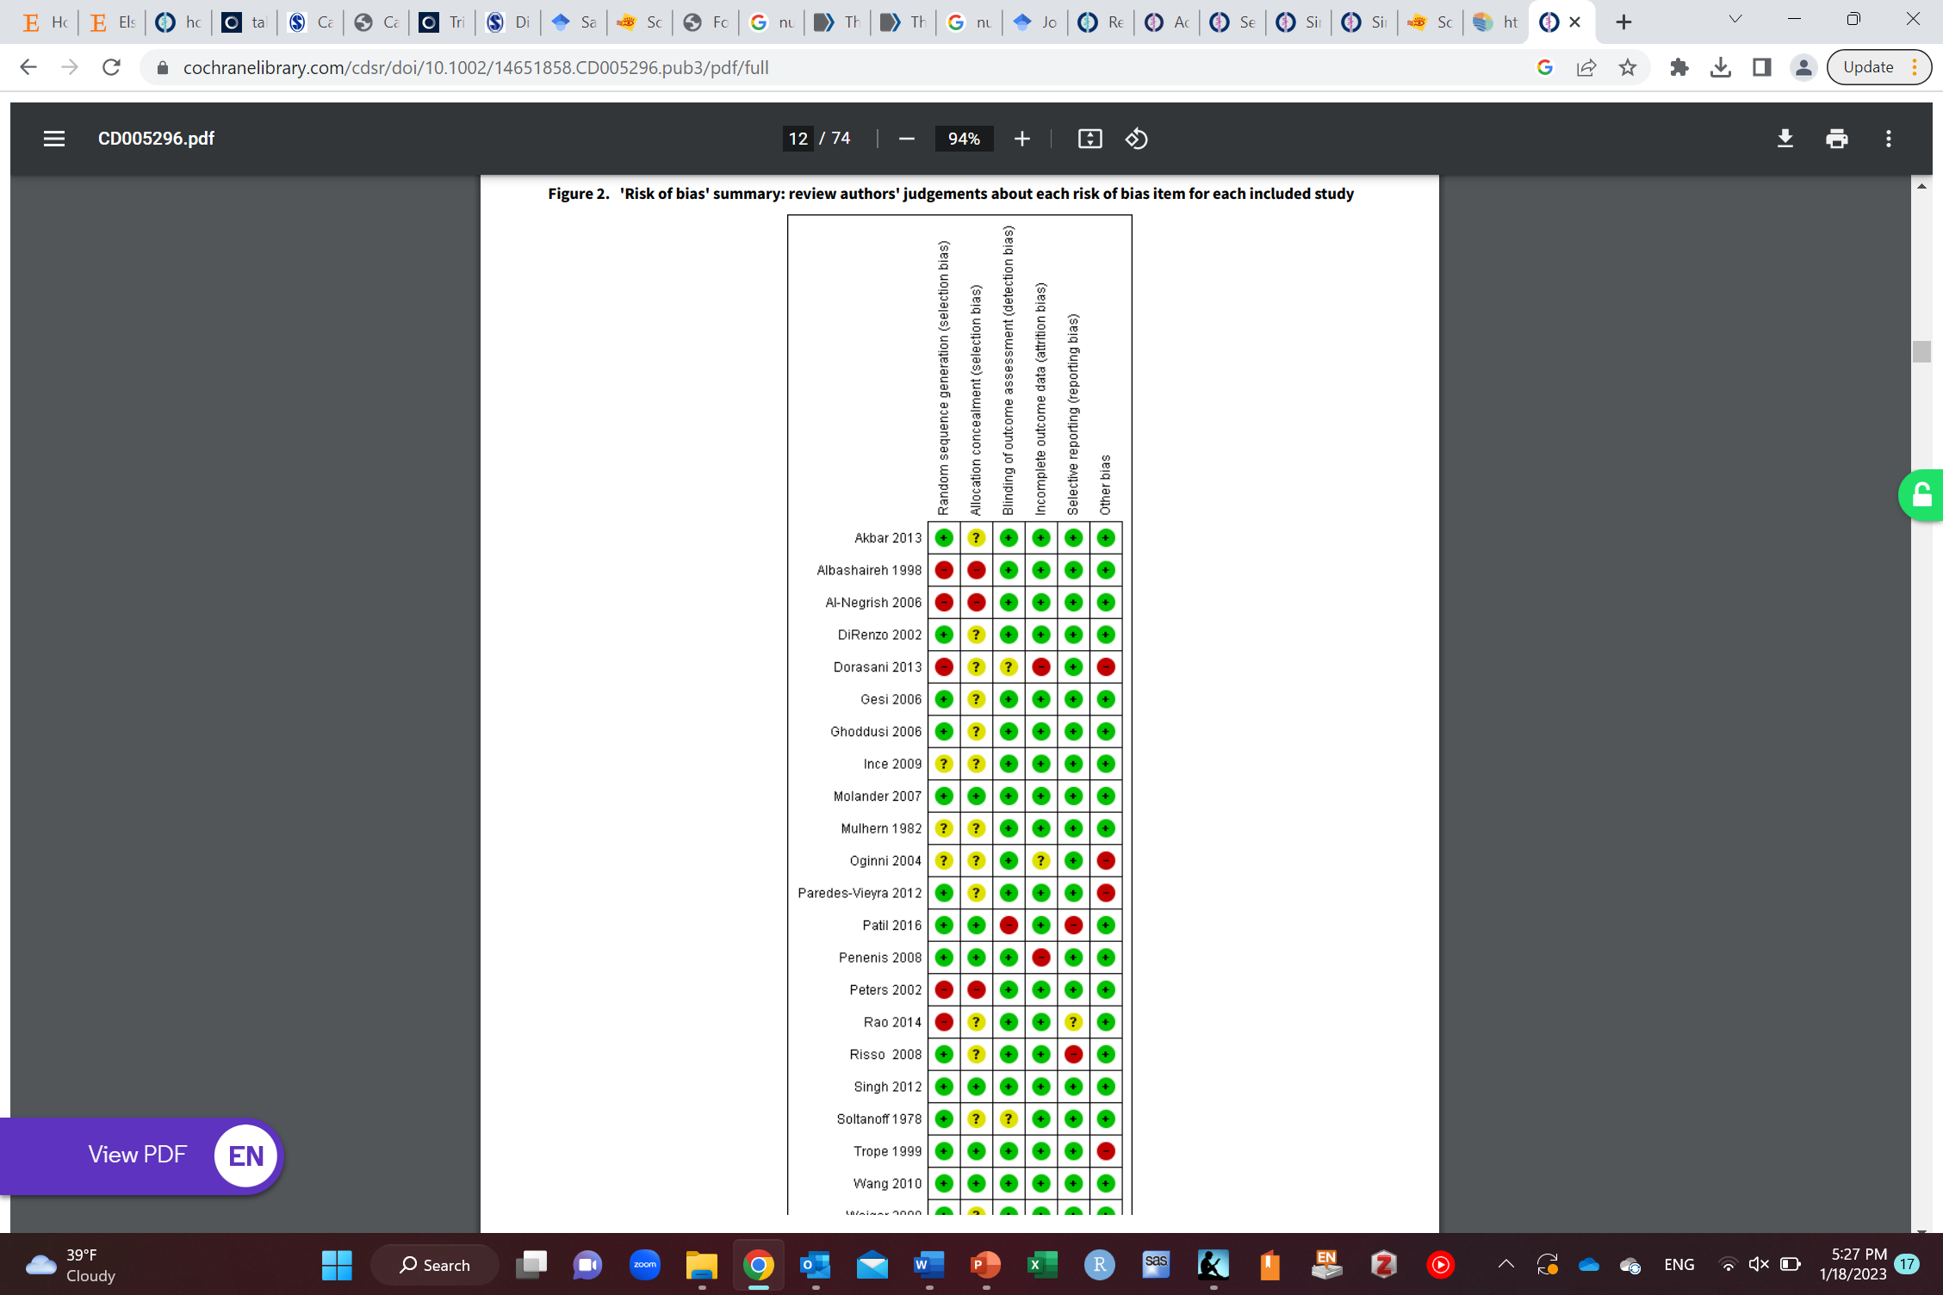
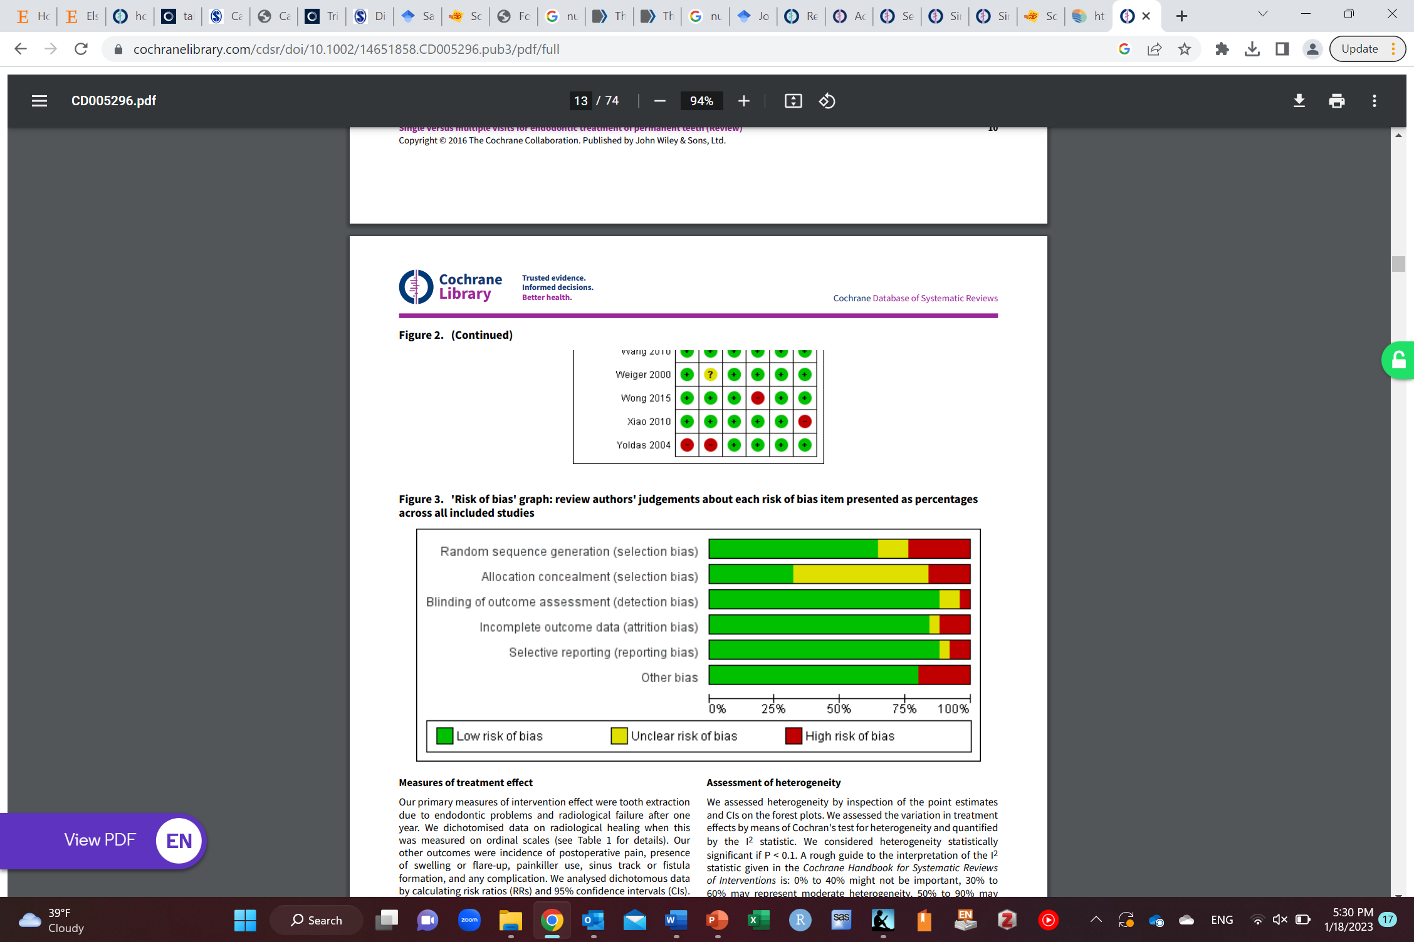

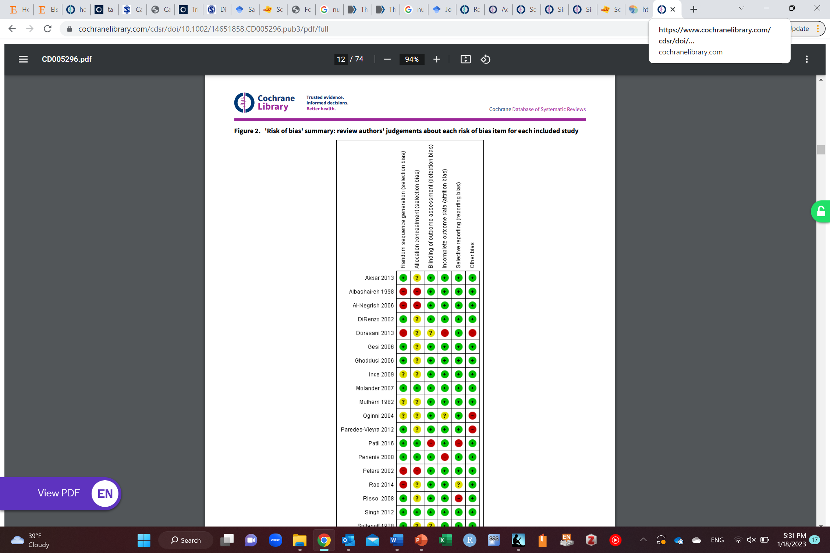
Often tally or counting (not good)

Slide 52
Conclude
Qualitative conclusion
May be quantitative using meta-analysis

Slide 53
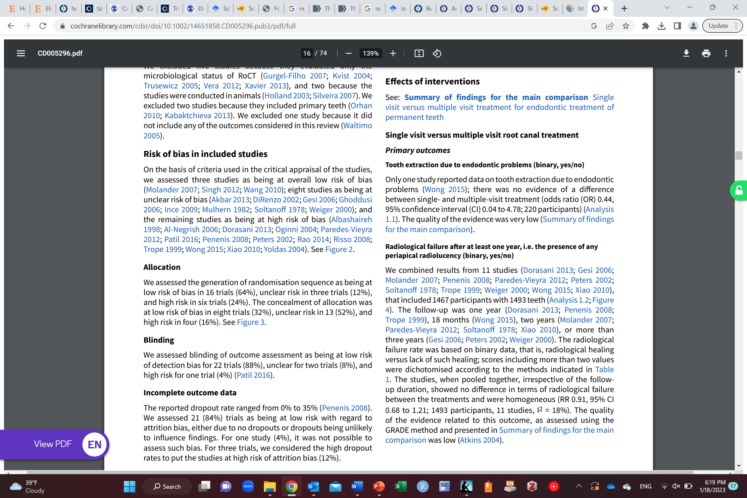

Slide 54
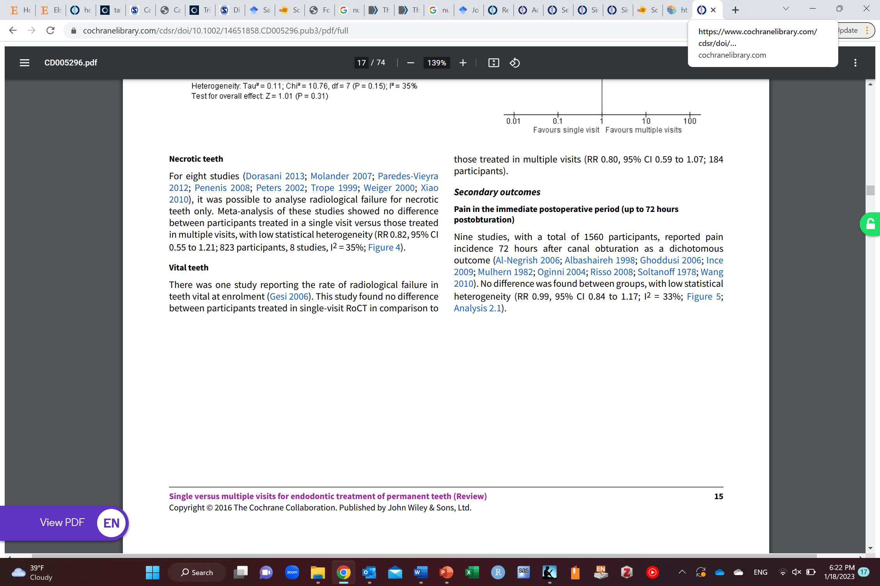

Slide 55
Meta-analysis
Quantitative analysis of the results of previous studies (not their raw data)
Idea is to combine results from different studies to get a single estimate in hope to investigate:
Differences between them
Increase the sample size

Slide 56
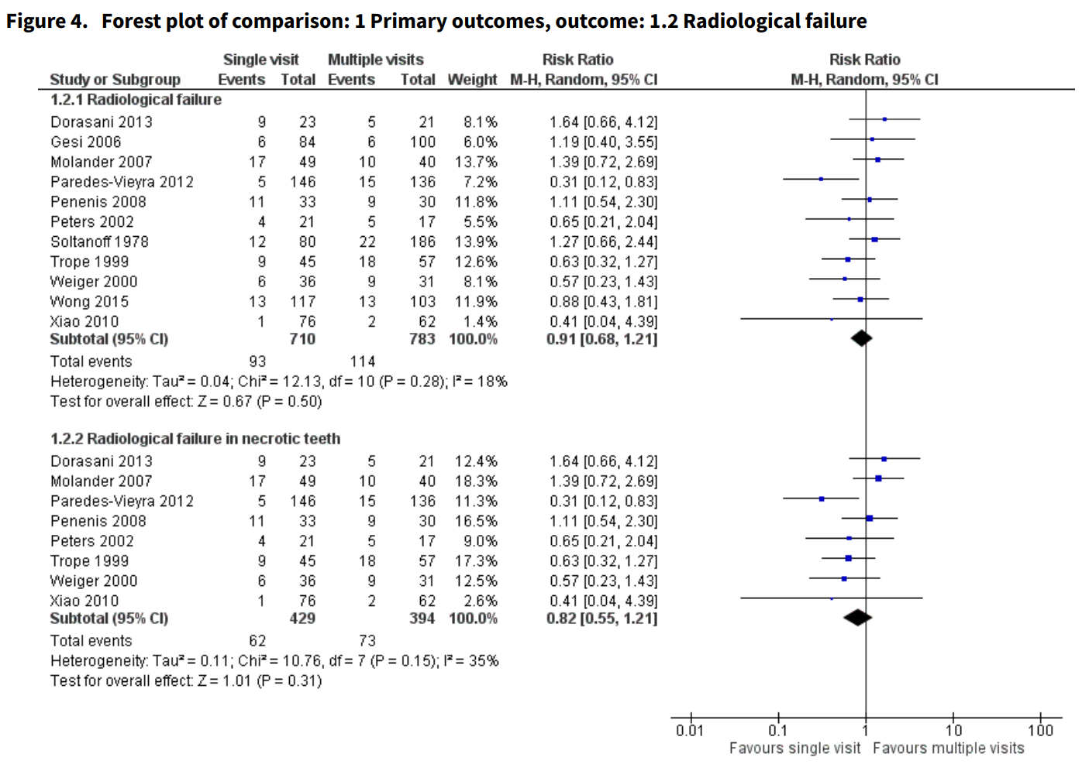

Slide 57
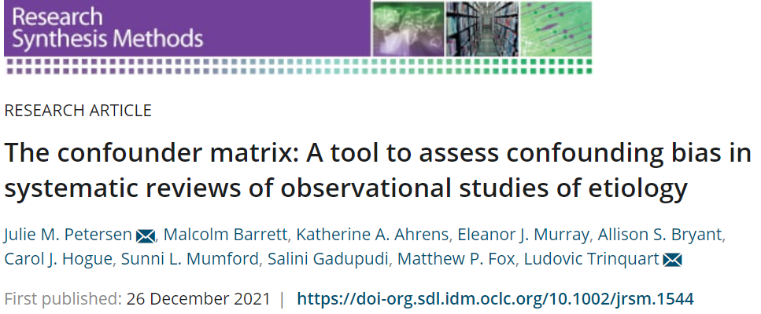

Slide 58
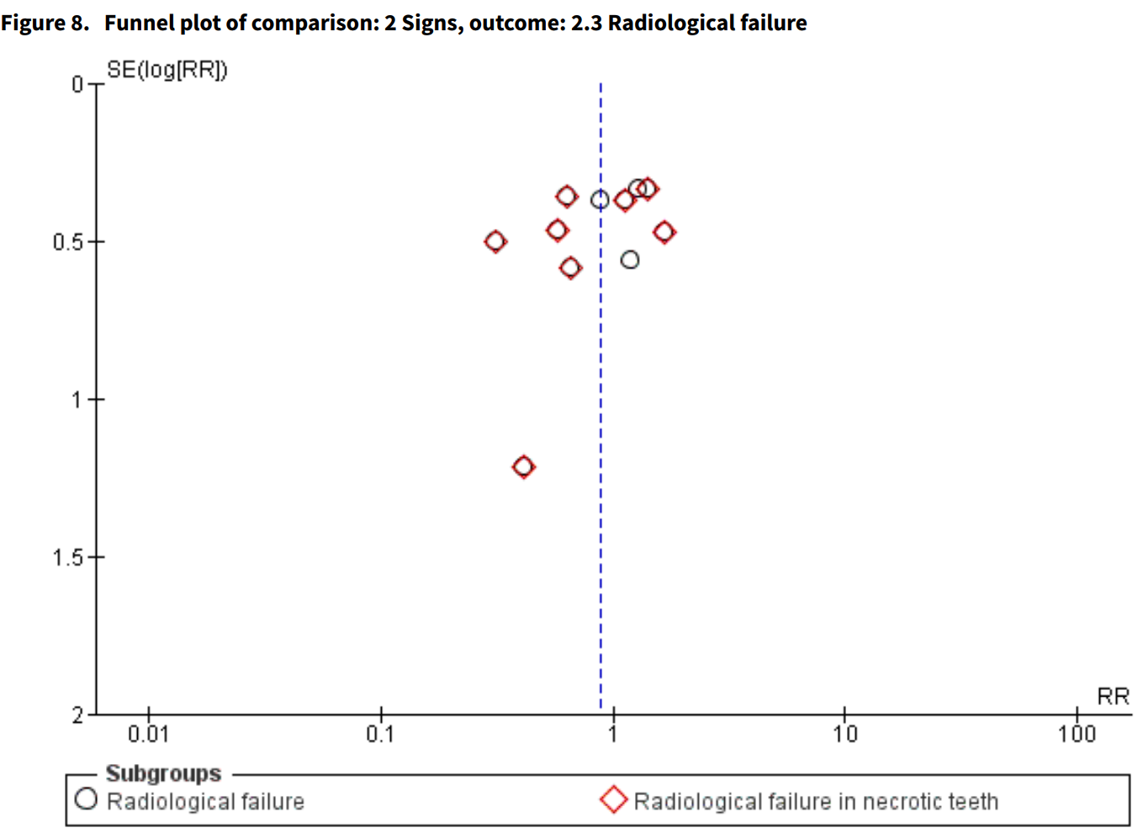
Publication bias

Slide 59
Publication bias
P-curve (look it up if interested)

Slide 60
Grey literature
Unpublished research (research done but not published in journals)
Thesis
Conference papers
Preprint
Can impact the results of the systematic review and meta-analysis

Slide 61
Meta-analysis
Garbage in garbage out

Slide 62
Individual Participant level meta-analysis
Analyze individual level data from all studies instead of analyzing their summary statistics

Slide 63
Network meta-analysis
Compares a lot of interventions instead of just two interventions

Slide 64
Software to help with systematic reviews and meta-analysis
Covidence (to facilitate screening of papers and data collection)
RevMan (for conducting metaanalysis)

Slide 65

“The practice of strengthening causal inferences by integrating results from several different approaches, where each approach has different (and assumed to be largely unrelated) key sources of potential bias.”
“Results from at least two, but ideally more, different approaches, with differing and unrelated key sources of potential biases, are compared.
The different approaches address the same underlying causal question.
Related to the above criterion, for each approach the duration and timing of exposure that it assesses is taken into account when comparing results.
For each approach the key sources of bias are explicitly acknowledged when comparing results.
For each approach the expected direction of all key sources of potential bias are made explicit where this is feasible, and ideally within the set of approaches being compared there are approaches with potential biases that are in opposite directions.”

Slide 66
Any Questions?
shihaybt@ksau-hs.edu.sa

